Slide 1
LOOPS IN JAVASCRIPT
By Faheem Ahmed

Slide 2
Loop statements:
The main strength of any programming language is its ability to process blocks of code repeatedly.
Computers are especially proficient at performing repeated calculations.
JavaScript, like other programming languages, provides us with loop.
Statements placed inside loops are executed a set number of times... or even infinitely.

Slide 3
Types of Loops
In JavaScript, there are different kind of loops:
  for -loop
  while –loop
  do-while loop

Slide 4
1.For loop:
The For loop are best used when you want to perform a loop in specific number of times.
for (initialize counter ; condition expression ; increment/decrement counter)
{
code to be executed
}

Slide 5
Aspects of for loop
There are four important aspects of a JavaScript for loop:
  The counter variable
  The conditional statement.
  The counter variable is incremented/decremented
  The code that is executed for each loop through the for loop.

Slide 6
Example
<script type=“text/javascript”>
var i;
for( i=0 ; i<10 ; i++)
{
document.write(“Javascript”);
}
</script>

Slide 7
Example 2
<html>
<body>
<script type="text/javascript">
var i=0;
for (i=0;i<=5;i++)
{
document.write("The number is " + i);
document.write("<br />");
}
</script>
</body>
</html>

Slide 8
When the JavaScript interpreter comes across a for loop, it executes the initialization statements
Then checks the condition. Only when the condition returns 'true', the interpreter enters the loop.
After the first iteration, the increment statements are executed and then the condition is evaluated again.
This continues till the condition returns 'false' and the loop stops.

Slide 9
2.The while Loop
The while loop loops through a block of code while a specified condition is true.
Syntax
while (condition)
{
code to be executed
}

Slide 10
<html>
<body>
<script type="text/javascript">
var i=0;
while (i<=5)
{
document.write("The number is " + i);
document.write("<br />");
i++;
}
</script>
</body>
</html>

Slide 11
for loop vs while loop:
for - loops through a block of code a specified number of times
while - loops through a block of code while a specified condition is true

Slide 12
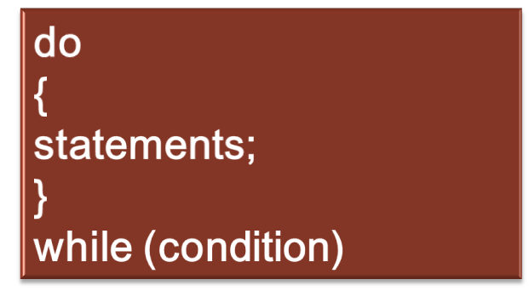
3.Do while loop
A do-while loop is very similar to the while loop.

Slide 13
<html>
<body>
<script type="text/javascript">
var i=0;
do
{
document.write("The number is " + i);
document.write("<br />");
i++;
}
while (i<=5);
</script>
</body>
</html>

Slide 14
Do while loop vs while loop
The do...while loop is similar to the while loop except that the condition check happens at the end of the loop.
This means that the loop will always be executed at least once, even if the condition is false.

